Slide 1
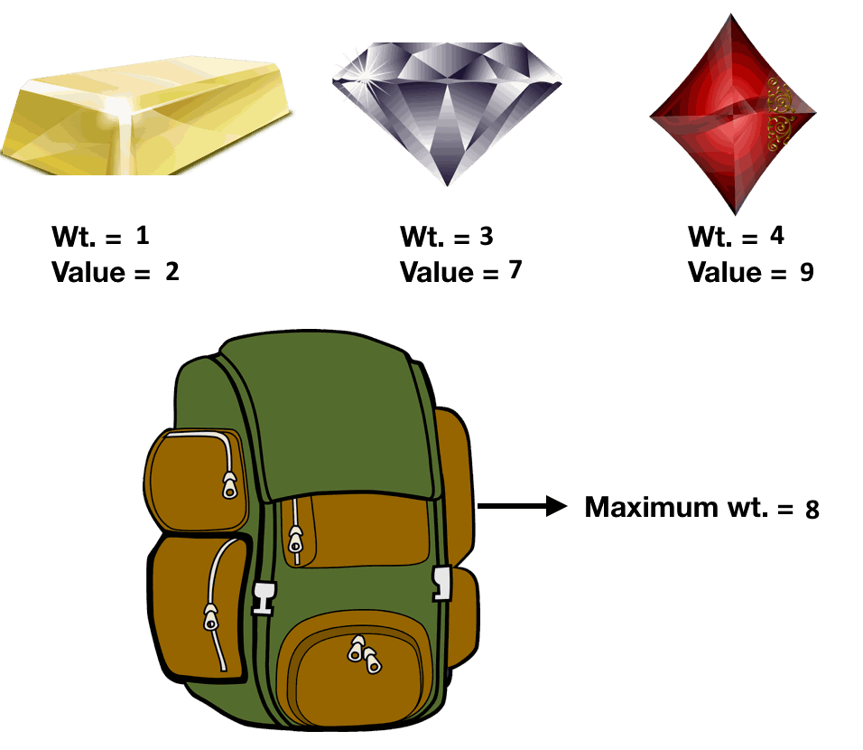
The 0-1 Knapsack Problem
Weight | Value
1 | 2
3 | 7
4 | 9
0 | 1 | 2 | 3 | 4 | 5 | 6 | 7 | 8
0 | 0 | 0 | 0 | 0 | 0 | 0 | 0 | 0

Slide 2
The 0-1 Knapsack Problem
Weight | Value
1 | 2
3 | 7
4 | 9
0 | 1 | 2 | 3 | 4 | 5 | 6 | 7 | 8
0 | 0 | 0 | 0 | 0 | 0 | 0 | 0 | 0
In this problem, we are constrained on only 1 dimension (the weight).
It’s called the 0-1 Knapsack problem because we can represent the inclusion/exclusion of the items as a bit array.
001 = no gold, no diamond, yes ruby
010 = no gold, yes diamond, no ruby
011 = no gold, yes diamond, yes ruby
100 = yes gold, no diamond, no ruby
101 = yes gold, no diamond, yes ruby
110 = yes gold, yes diamond, no ruby
111 = yes gold, yes diamond, yes ruby
2^{n} possible configurations

Slide 3
The 0-1 Knapsack Problem
Weight | Value
1 | 2
3 | 7
4 | 9
0 | 1 | 2 | 3 | 4 | 5 | 6 | 7 | 8
0 | 0 | 0 | 0 | 0 | 0 | 0 | 0 | 0
In this problem, we are constrained on only 1 dimension (the weight).
It’s called the 0-1 Knapsack problem because we can represent the inclusion/exclusion of the items as a bit array.
In the brute-force approach we just test all 2^{n} possibilities giving it a time complexity of Ѳ(2^{n}).

Slide 4
Case 1: Unlimited Treasures!
Weight | Value
1 | 2
3 | 7
4 | 9
0 | 1 | 2 | 3 | 4 | 5 | 6 | 7 | 8
0 | 0 | 0 | 0 | 0 | 0 | 0 | 0 | 0

Slide 5
Case 1: Unlimited Treasures!
Weight | Value
1 | 2
3 | 7
4 | 9
0 | 1 | 2 | 3 | 4 | 5 | 6 | 7 | 8
0 | 0 | 0 | 0 | 0 | 0 | 0 | 0 | 0
+2
0
max of..

Slide 6
Case 1: Unlimited Treasures!
Weight | Value
1 | 2
3 | 7
4 | 9
0 | 1 | 2 | 3 | 4 | 5 | 6 | 7 | 8
0 | 0 | 0 | 0 | 0 | 0 | 0 | 0 | 0
+2
0 | 2
max of..

Slide 7
Case 1: Unlimited Treasures!
Weight | Value
1 | 2
3 | 7
4 | 9
0 | 1 | 2 | 3 | 4 | 5 | 6 | 7 | 8
0 | 0 | 0 | 0 | 0 | 0 | 0 | 0 | 0
+2
0 | 2 | 4
max of..

Slide 8
Case 1: Unlimited Treasures!
Weight | Value
1 | 2
3 | 7
4 | 9
0 | 1 | 2 | 3 | 4 | 5 | 6 | 7 | 8
0 | 0 | 0 | 0 | 0 | 0 | 0 | 0 | 0
+2
0 | 2 | 4 | 6
max of..

Slide 9
Case 1: Unlimited Treasures!
Weight | Value
1 | 2
3 | 7
4 | 9
0 | 1 | 2 | 3 | 4 | 5 | 6 | 7 | 8
0 | 0 | 0 | 0 | 0 | 0 | 0 | 0 | 0
0 | 2 | 4 | 6 | 8 | 10 | 12 | 14 | 16

Slide 10
Case 1: Unlimited Treasures!
Weight | Value
1 | 2
3 | 7
4 | 9
0 | 1 | 2 | 3 | 4 | 5 | 6 | 7 | 8
0 | 0 | 0 | 0 | 0 | 0 | 0 | 0 | 0
0 | 2 | 4 | 6 | 8 | 10 | 12 | 14 | 16
+7
0 | 2 | 4
max of..

Slide 11
Case 1: Unlimited Treasures!
Weight | Value
1 | 2
3 | 7
4 | 9
0 | 1 | 2 | 3 | 4 | 5 | 6 | 7 | 8
0 | 0 | 0 | 0 | 0 | 0 | 0 | 0 | 0
0 | 2 | 4 | 6 | 8 | 10 | 12 | 14 | 16
+7
0 | 2 | 4 | 7
max of..

Slide 12
Case 1: Unlimited Treasures!
Weight | Value
1 | 2
3 | 7
4 | 9
0 | 1 | 2 | 3 | 4 | 5 | 6 | 7 | 8
0 | 0 | 0 | 0 | 0 | 0 | 0 | 0 | 0
0 | 2 | 4 | 6 | 8 | 10 | 12 | 14 | 16
+7
0 | 2 | 4 | 7 | 9
max of..

Slide 13
Case 1: Unlimited Treasures!
Weight | Value
1 | 2
3 | 7
4 | 9
0 | 1 | 2 | 3 | 4 | 5 | 6 | 7 | 8
0 | 0 | 0 | 0 | 0 | 0 | 0 | 0 | 0
0 | 2 | 4 | 6 | 8 | 10 | 12 | 14 | 16
+7
0 | 2 | 4 | 7 | 9 | 11
max of..

Slide 14
Case 1: Unlimited Treasures!
Weight | Value
1 | 2
3 | 7
4 | 9
0 | 1 | 2 | 3 | 4 | 5 | 6 | 7 | 8
0 | 0 | 0 | 0 | 0 | 0 | 0 | 0 | 0
0 | 2 | 4 | 6 | 8 | 10 | 12 | 14 | 16
0 | 2 | 4 | 7 | 9 | 11 | 14 | 16 | 18

Slide 15
Case 1: Unlimited Treasures!
Weight | Value
1 | 2
3 | 7
4 | 9
0 | 1 | 2 | 3 | 4 | 5 | 6 | 7 | 8
0 | 0 | 0 | 0 | 0 | 0 | 0 | 0 | 0
0 | 2 | 4 | 6 | 8 | 10 | 12 | 14 | 16
0 | 2 | 4 | 7 | 9 | 11 | 14 | 16 | 18
+9
0 | 2 | 4 | 7
max of..

Slide 16
Case 1: Unlimited Treasures!
Weight | Value
1 | 2
3 | 7
4 | 9
0 | 1 | 2 | 3 | 4 | 5 | 6 | 7 | 8
0 | 0 | 0 | 0 | 0 | 0 | 0 | 0 | 0
0 | 2 | 4 | 6 | 8 | 10 | 12 | 14 | 16
0 | 2 | 4 | 7 | 9 | 11 | 14 | 16 | 18
+9
0 | 2 | 4 | 7 | 9
max of..

Slide 17
Case 1: Unlimited Treasures!
Weight | Value
1 | 2
3 | 7
4 | 9
0 | 1 | 2 | 3 | 4 | 5 | 6 | 7 | 8
0 | 0 | 0 | 0 | 0 | 0 | 0 | 0 | 0
0 | 2 | 4 | 6 | 8 | 10 | 12 | 14 | 16
0 | 2 | 4 | 7 | 9 | 11 | 14 | 16 | 18
+9
0 | 2 | 4 | 7 | 9 | 11
max of..

Slide 18
Case 1: Unlimited Treasures!
Weight | Value
1 | 2
3 | 7
4 | 9
0 | 1 | 2 | 3 | 4 | 5 | 6 | 7 | 8
0 | 0 | 0 | 0 | 0 | 0 | 0 | 0 | 0
0 | 2 | 4 | 6 | 8 | 10 | 12 | 14 | 16
0 | 2 | 4 | 7 | 9 | 11 | 14 | 16 | 18
+9
0 | 2 | 4 | 7 | 9 | 11 | 14
max of..

Slide 19
Case 1: Unlimited Treasures!
Weight | Value
1 | 2
3 | 7
4 | 9
0 | 1 | 2 | 3 | 4 | 5 | 6 | 7 | 8
0 | 0 | 0 | 0 | 0 | 0 | 0 | 0 | 0
0 | 2 | 4 | 6 | 8 | 10 | 12 | 14 | 16
0 | 2 | 4 | 7 | 9 | 11 | 14 | 16 | 18
0 | 2 | 4 | 7 | 9 | 11 | 14 | 16 | 18

Slide 20
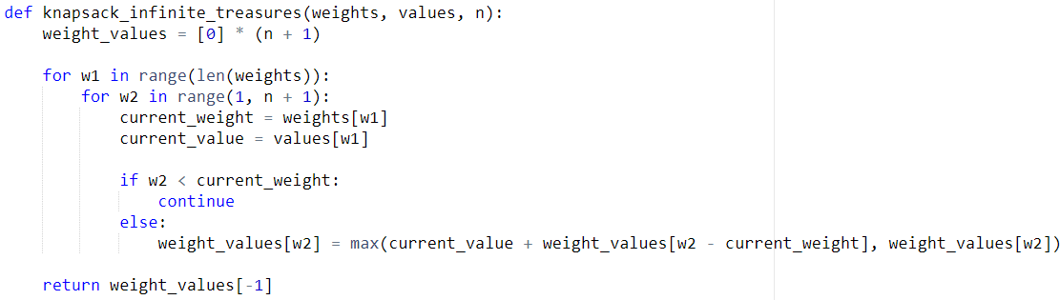
Case 1: Unlimited Treasures!
Weight | Value
1 | 2
3 | 7
4 | 9
0 | 1 | 2 | 3 | 4 | 5 | 6 | 7 | 8
0 | 0 | 0 | 0 | 0 | 0 | 0 | 0 | 0
0 | 2 | 4 | 6 | 8 | 10 | 12 | 14 | 16
0 | 2 | 4 | 7 | 9 | 11 | 14 | 16 | 18
0 | 2 | 4 | 7 | 9 | 11 | 14 | 16 | 18

Slide 21
Case 1: Unlimited Treasures!
Weight | Value
1 | 2
3 | 7
4 | 9
0 | 1 | 2 | 3 | 4 | 5 | 6 | 7 | 8
0 | 0 | 0 | 0 | 0 | 0 | 0 | 0 | 0
0 | 2 | 4 | 6 | 8 | 10 | 12 | 14 | 16
0 | 2 | 4 | 7 | 9 | 11 | 14 | 16 | 18
0 | 2 | 4 | 7 | 9 | 11 | 14 | 16 | 18
Sets up the 0s at the start

Slide 22
Case 1: Unlimited Treasures!
Weight | Value
1 | 2
3 | 7
4 | 9
0 | 1 | 2 | 3 | 4 | 5 | 6 | 7 | 8
0 | 0 | 0 | 0 | 0 | 0 | 0 | 0 | 0
0 | 2 | 4 | 6 | 8 | 10 | 12 | 14 | 16
0 | 2 | 4 | 7 | 9 | 11 | 14 | 16 | 18
0 | 2 | 4 | 7 | 9 | 11 | 14 | 16 | 18
Loops through items

Slide 23
Case 1: Unlimited Treasures!
Weight | Value
1 | 2
3 | 7
4 | 9
0 | 1 | 2 | 3 | 4 | 5 | 6 | 7 | 8
0 | 0 | 0 | 0 | 0 | 0 | 0 | 0 | 0
0 | 2 | 4 | 6 | 8 | 10 | 12 | 14 | 16
0 | 2 | 4 | 7 | 9 | 11 | 14 | 16 | 18
0 | 2 | 4 | 7 | 9 | 11 | 14 | 16 | 18
Loops through weight increments

Slide 24
Case 1: Unlimited Treasures!
Weight | Value
1 | 2
3 | 7
4 | 9
0 | 1 | 2 | 3 | 4 | 5 | 6 | 7 | 8
0 | 0 | 0 | 0 | 0 | 0 | 0 | 0 | 0
0 | 2 | 4 | 6 | 8 | 10 | 12 | 14 | 16
0 | 2 | 4 | 7 | 9 | 11 | 14 | 16 | 18
0 | 2 | 4 | 7 | 9 | 11 | 14 | 16 | 18
Skips all weight increments less than the item weight

Slide 25
Case 1: Unlimited Treasures!
Weight | Value
1 | 2
3 | 7
4 | 9
0 | 1 | 2 | 3 | 4 | 5 | 6 | 7 | 8
0 | 0 | 0 | 0 | 0 | 0 | 0 | 0 | 0
0 | 2 | 4 | 6 | 8 | 10 | 12 | 14 | 16
0 | 2 | 4 | 7 | 9 | 11 | 14 | 16 | 18
0 | 2 | 4 | 7 | 9 | 11 | 14 | 16 | 18
Solve the overlapping subproblems

Slide 26
Case 1: Unlimited Treasures!
Weight | Value
1 | 2
3 | 7
4 | 9
0 | 1 | 2 | 3 | 4 | 5 | 6 | 7 | 8
0 | 0 | 0 | 0 | 0 | 0 | 0 | 0 | 0
0 | 2 | 4 | 6 | 8 | 10 | 12 | 14 | 16
0 | 2 | 4 | 7 | 9 | 11 | 14 | 16 | 18
0 | 2 | 4 | 7 | 9 | 11 | 14 | 16 | 18
O(n*w)
where n is the maximum weight,
and w is number of items

Slide 27
Case 2: Limited Treasures, 1 of each
Weight | Value
1 | 2
3 | 7
4 | 9
0 | 1 | 2 | 3 | 4 | 5 | 6 | 7 | 8
0 | 0 | 0 | 0 | 0 | 0 | 0 | 0 | 0

Slide 28
Case 2: Limited Treasures, 1 of each
Weight | Value
1 | 2
3 | 7
4 | 9
0 | 1 | 2 | 3 | 4 | 5 | 6 | 7 | 8
0 | 0 | 0 | 0 | 0 | 0 | 0 | 0 | 0
+2
0 | 0 | 0 | 0 | 0 | 0 | 0 | 0
max of..

Slide 29
Case 2: Limited Treasures, 1 of each
Weight | Value
1 | 2
3 | 7
4 | 9
0 | 1 | 2 | 3 | 4 | 5 | 6 | 7 | 8
0 | 0 | 0 | 0 | 0 | 0 | 0 | 0 | 0
+2
0 | 0 | 0 | 0 | 0 | 0 | 0 |  | 2
max of..

Slide 30
Case 2: Limited Treasures, 1 of each
Weight | Value
1 | 2
3 | 7
4 | 9
0 | 1 | 2 | 3 | 4 | 5 | 6 | 7 | 8
0 | 0 | 0 | 0 | 0 | 0 | 0 | 0 | 0
+2
0 | 0 | 0 | 0 | 0 | 0 |  | 2 | 2
max of..

Slide 31
Case 2: Limited Treasures, 1 of each
Weight | Value
1 | 2
3 | 7
4 | 9
0 | 1 | 2 | 3 | 4 | 5 | 6 | 7 | 8
0 | 0 | 0 | 0 | 0 | 0 | 0 | 0 | 0
+2
0 | 0 | 0 | 0 | 0 |  | 2 | 2 | 2
max of..

Slide 32
Case 2: Limited Treasures, 1 of each
Weight | Value
1 | 2
3 | 7
4 | 9
0 | 1 | 2 | 3 | 4 | 5 | 6 | 7 | 8
0 | 0 | 0 | 0 | 0 | 0 | 0 | 0 | 0
0 | 2 | 2 | 2 | 2 | 2 | 2 | 2 | 2

Slide 33
Case 2: Limited Treasures, 1 of each
Weight | Value
1 | 2
3 | 7
4 | 9
0 | 1 | 2 | 3 | 4 | 5 | 6 | 7 | 8
0 | 0 | 0 | 0 | 0 | 0 | 0 | 0 | 0
0 | 2 | 2 | 2 | 2 | 2 | 2 | 2 | 2
+7
0 | 2 | 2 | 2 | 2 | 2 | 2 | 2
max of..

Slide 34
Case 2: Limited Treasures, 1 of each
Weight | Value
1 | 2
3 | 7
4 | 9
0 | 1 | 2 | 3 | 4 | 5 | 6 | 7 | 8
0 | 0 | 0 | 0 | 0 | 0 | 0 | 0 | 0
0 | 2 | 2 | 2 | 2 | 2 | 2 | 2 | 2
+7
0 | 2 | 2 | 2 | 2 | 2 | 2 |  | 9
max of..

Slide 35
Case 2: Limited Treasures, 1 of each
Weight | Value
1 | 2
3 | 7
4 | 9
0 | 1 | 2 | 3 | 4 | 5 | 6 | 7 | 8
0 | 0 | 0 | 0 | 0 | 0 | 0 | 0 | 0
0 | 2 | 2 | 2 | 2 | 2 | 2 | 2 | 2
+7
0 | 2 | 2 | 2 | 2 | 2 |  | 9 | 9
max of..

Slide 36
Case 2: Limited Treasures, 1 of each
Weight | Value
1 | 2
3 | 7
4 | 9
0 | 1 | 2 | 3 | 4 | 5 | 6 | 7 | 8
0 | 0 | 0 | 0 | 0 | 0 | 0 | 0 | 0
0 | 2 | 2 | 2 | 2 | 2 | 2 | 2 | 2
+7
0 | 2 | 2 | 2 | 2 |  | 9 | 9 | 9
max of..

Slide 37
Case 2: Limited Treasures, 1 of each
Weight | Value
1 | 2
3 | 7
4 | 9
0 | 1 | 2 | 3 | 4 | 5 | 6 | 7 | 8
0 | 0 | 0 | 0 | 0 | 0 | 0 | 0 | 0
0 | 2 | 2 | 2 | 2 | 2 | 2 | 2 | 2
+7
0 | 2 | 2 | 2 |  | 9 | 9 | 9 | 9
max of..

Slide 38
Case 2: Limited Treasures, 1 of each
Weight | Value
1 | 2
3 | 7
4 | 9
0 | 1 | 2 | 3 | 4 | 5 | 6 | 7 | 8
0 | 0 | 0 | 0 | 0 | 0 | 0 | 0 | 0
0 | 2 | 2 | 2 | 2 | 2 | 2 | 2 | 2
+7
0 | 2 | 2 |  | 9 | 9 | 9 | 9 | 9
max of..

Slide 39
Case 2: Limited Treasures, 1 of each
Weight | Value
1 | 2
3 | 7
4 | 9
0 | 1 | 2 | 3 | 4 | 5 | 6 | 7 | 8
0 | 0 | 0 | 0 | 0 | 0 | 0 | 0 | 0
0 | 2 | 2 | 2 | 2 | 2 | 2 | 2 | 2
0 | 2 | 2 | 7 | 9 | 9 | 9 | 9 | 9

Slide 40
Case 2: Limited Treasures, 1 of each
Weight | Value
1 | 2
3 | 7
4 | 9
0 | 1 | 2 | 3 | 4 | 5 | 6 | 7 | 8
0 | 0 | 0 | 0 | 0 | 0 | 0 | 0 | 0
0 | 2 | 2 | 2 | 2 | 2 | 2 | 2 | 2
0 | 2 | 2 | 7 | 9 | 9 | 9 | 9 | 9
+9
0 | 2 | 2 | 7 | 9 | 9 | 9 | 9
max of..

Slide 41
Case 2: Limited Treasures, 1 of each
Weight | Value
1 | 2
3 | 7
4 | 9
0 | 1 | 2 | 3 | 4 | 5 | 6 | 7 | 8
0 | 0 | 0 | 0 | 0 | 0 | 0 | 0 | 0
0 | 2 | 2 | 2 | 2 | 2 | 2 | 2 | 2
0 | 2 | 2 | 7 | 9 | 9 | 9 | 9 | 9
+9
0 | 2 | 2 | 7 | 9 | 9 | 9 |  | 18
max of..

Slide 42
Case 2: Limited Treasures, 1 of each
Weight | Value
1 | 2
3 | 7
4 | 9
0 | 1 | 2 | 3 | 4 | 5 | 6 | 7 | 8
0 | 0 | 0 | 0 | 0 | 0 | 0 | 0 | 0
0 | 2 | 2 | 2 | 2 | 2 | 2 | 2 | 2
0 | 2 | 2 | 7 | 9 | 9 | 9 | 9 | 9
+9
0 | 2 | 2 | 7 | 9 | 9 |  | 16 | 18
max of..

Slide 43
Case 2: Limited Treasures, 1 of each
Weight | Value
1 | 2
3 | 7
4 | 9
0 | 1 | 2 | 3 | 4 | 5 | 6 | 7 | 8
0 | 0 | 0 | 0 | 0 | 0 | 0 | 0 | 0
0 | 2 | 2 | 2 | 2 | 2 | 2 | 2 | 2
0 | 2 | 2 | 7 | 9 | 9 | 9 | 9 | 9
+9
0 | 2 | 2 | 7 | 9 |  | 11 | 16 | 18
max of..

Slide 44
Case 2: Limited Treasures, 1 of each
Weight | Value
1 | 2
3 | 7
4 | 9
0 | 1 | 2 | 3 | 4 | 5 | 6 | 7 | 8
0 | 0 | 0 | 0 | 0 | 0 | 0 | 0 | 0
0 | 2 | 2 | 2 | 2 | 2 | 2 | 2 | 2
0 | 2 | 2 | 7 | 9 | 9 | 9 | 9 | 9
+9
0 | 2 | 2 | 7 |  | 11 | 11 | 16 | 18
max of..

Slide 45
Case 2: Limited Treasures, 1 of each
Weight | Value
1 | 2
3 | 7
4 | 9
0 | 1 | 2 | 3 | 4 | 5 | 6 | 7 | 8
0 | 0 | 0 | 0 | 0 | 0 | 0 | 0 | 0
0 | 2 | 2 | 2 | 2 | 2 | 2 | 2 | 2
0 | 2 | 2 | 7 | 9 | 9 | 9 | 9 | 9
0 | 2 | 2 | 7 | 9 | 11 | 11 | 16 | 18

Slide 46
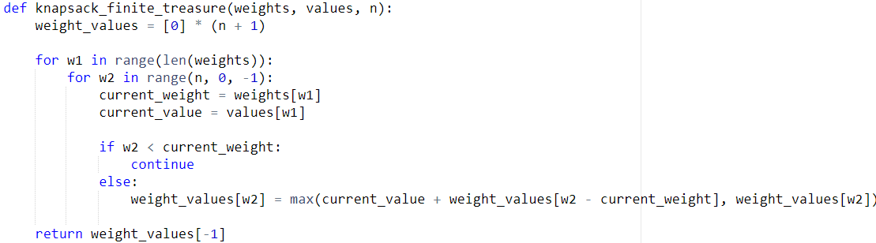
Case 2: Limited Treasures, 1 of each
Weight | Value
1 | 2
3 | 7
4 | 9
0 | 1 | 2 | 3 | 4 | 5 | 6 | 7 | 8
0 | 0 | 0 | 0 | 0 | 0 | 0 | 0 | 0
0 | 2 | 2 | 2 | 2 | 2 | 2 | 2 | 2
0 | 2 | 2 | 7 | 9 | 9 | 9 | 9 | 9
0 | 2 | 2 | 7 | 9 | 11 | 11 | 16 | 18

Slide 47
Case 2: Limited Treasures, 1 of each
Weight | Value
1 | 2
3 | 7
4 | 9
0 | 1 | 2 | 3 | 4 | 5 | 6 | 7 | 8
0 | 0 | 0 | 0 | 0 | 0 | 0 | 0 | 0
0 | 2 | 2 | 2 | 2 | 2 | 2 | 2 | 2
0 | 2 | 2 | 7 | 9 | 9 | 9 | 9 | 9
0 | 2 | 2 | 7 | 9 | 11 | 11 | 16 | 18
Sets up 0s at the start

Slide 48
Case 2: Limited Treasures, 1 of each
Weight | Value
1 | 2
3 | 7
4 | 9
0 | 1 | 2 | 3 | 4 | 5 | 6 | 7 | 8
0 | 0 | 0 | 0 | 0 | 0 | 0 | 0 | 0
0 | 2 | 2 | 2 | 2 | 2 | 2 | 2 | 2
0 | 2 | 2 | 7 | 9 | 9 | 9 | 9 | 9
0 | 2 | 2 | 7 | 9 | 11 | 11 | 16 | 18
Loop through items

Slide 49
Case 2: Limited Treasures, 1 of each
Weight | Value
1 | 2
3 | 7
4 | 9
0 | 1 | 2 | 3 | 4 | 5 | 6 | 7 | 8
0 | 0 | 0 | 0 | 0 | 0 | 0 | 0 | 0
0 | 2 | 2 | 2 | 2 | 2 | 2 | 2 | 2
0 | 2 | 2 | 7 | 9 | 9 | 9 | 9 | 9
0 | 2 | 2 | 7 | 9 | 11 | 11 | 16 | 18
Loops through weight increments -
in reverse order to prevent “doubling up”

Slide 50
Case 2: Limited Treasures, 1 of each
Weight | Value
1 | 2
3 | 7
4 | 9
0 | 1 | 2 | 3 | 4 | 5 | 6 | 7 | 8
0 | 0 | 0 | 0 | 0 | 0 | 0 | 0 | 0
0 | 2 | 2 | 2 | 2 | 2 | 2 | 2 | 2
0 | 2 | 2 | 7 | 9 | 9 | 9 | 9 | 9
0 | 2 | 2 | 7 | 9 | 11 | 11 | 16 | 18
Skip weight increments less than the item weight

Slide 51
Case 2: Limited Treasures, 1 of each
Weight | Value
1 | 2
3 | 7
4 | 9
0 | 1 | 2 | 3 | 4 | 5 | 6 | 7 | 8
0 | 0 | 0 | 0 | 0 | 0 | 0 | 0 | 0
0 | 2 | 2 | 2 | 2 | 2 | 2 | 2 | 2
0 | 2 | 2 | 7 | 9 | 9 | 9 | 9 | 9
0 | 2 | 2 | 7 | 9 | 11 | 11 | 16 | 18
Solve overlapping subproblem

Slide 52
Case 2: Limited Treasures, 1 of each
Weight | Value
1 | 2
3 | 7
4 | 9
0 | 1 | 2 | 3 | 4 | 5 | 6 | 7 | 8
0 | 0 | 0 | 0 | 0 | 0 | 0 | 0 | 0
0 | 2 | 2 | 2 | 2 | 2 | 2 | 2 | 2
0 | 2 | 2 | 7 | 9 | 9 | 9 | 9 | 9
0 | 2 | 2 | 7 | 9 | 11 | 11 | 16 | 18
O(n*w)
where n is the maximum weight,
and w is number of items

Slide 53
Implementation for both cases are exactly the same… except for the order of iteration through the weight increments

